Slide 1

Arrays and Strings
Prof. Darrell Long
CSE 13S

Slide 2
What is an array?
It is a homogeneous collection of elements
All elements have the same type.
Arrays can have one dimension
Often called a vector.
Arrays can have two dimensions
Often called a matrix.
C treats a matrix as an array of vectors.
Arrays can have even more dimensions
Often called a tensor by the machine learning community.
C treats these as arrays of arrays of … some type.

Slide 3
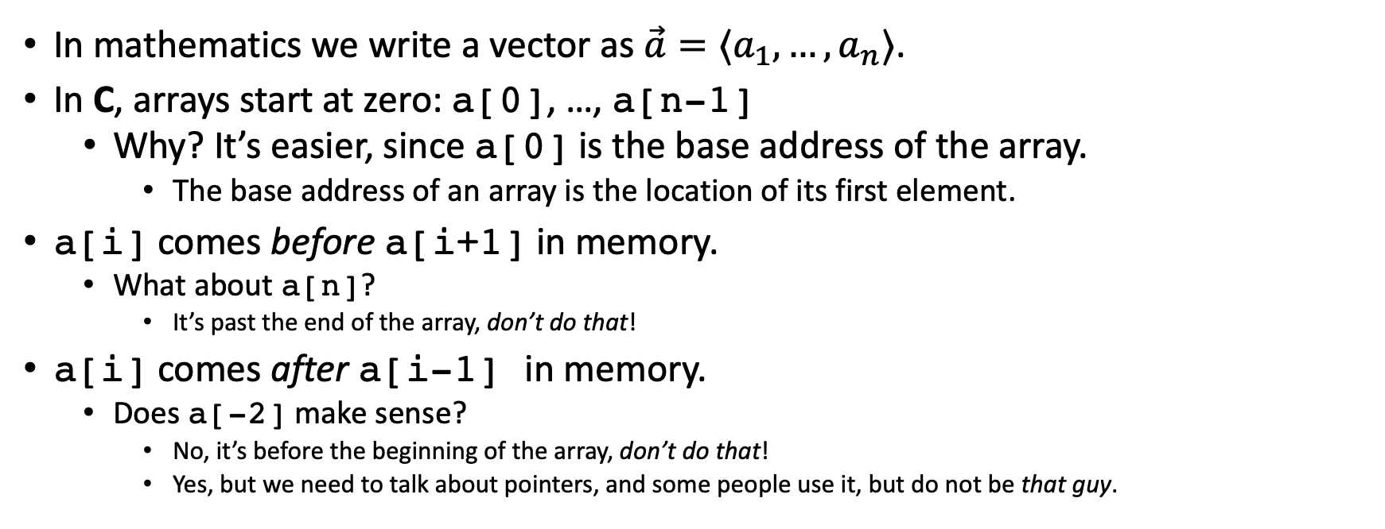
Arrays are ordered
In mathematics we write a vector as $\vec{a}=⟨a_{1},…,a_{n}⟩$.
In C, arrays start at zero: a[0], …, a[n-1]
Why? It’s easier, since a[0] is the base address of the array.
The base address of an array is the location of its first element.
a[i] comes before a[i+1] in memory.
What about a[n]?
It’s past the end of the array, don’t do that!
a[i] comes after a[i-1] in memory.
Does a[-2] make sense?
No, it’s before the beginning of the array, don’t do that!
Yes, but we need to talk about pointers, and some people use it, but do not be that guy.

Slide 4
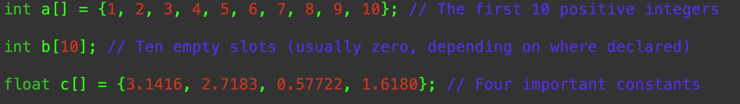
Declaring an array
type name [ count ] = { initialization list }
If you have an initialization list, then you don’t need a count.
If you have a count, then you don’t need an initialization list.
But you can have one, of course.
If the list is too short, then C will fill the rest with zero.

Slide 5
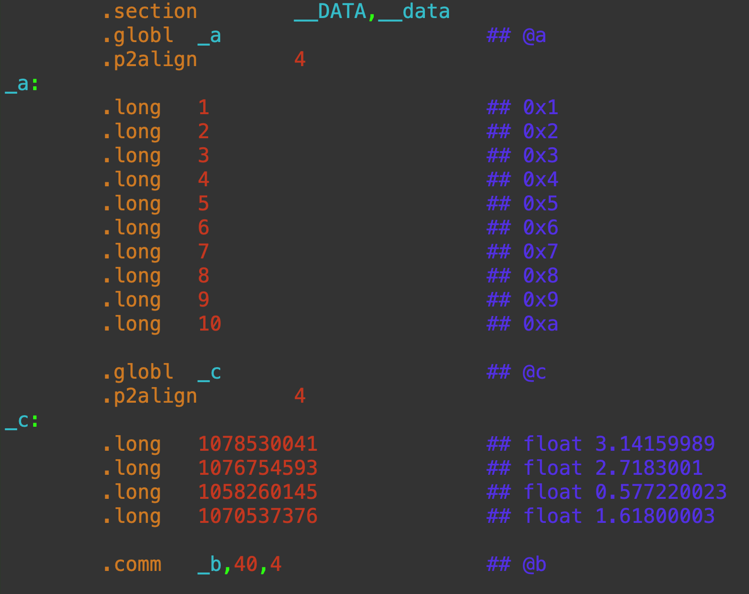
In Memory
The assembly language shows us what is really happening.
__a is the base address of the array in assembly language.

Slide 6
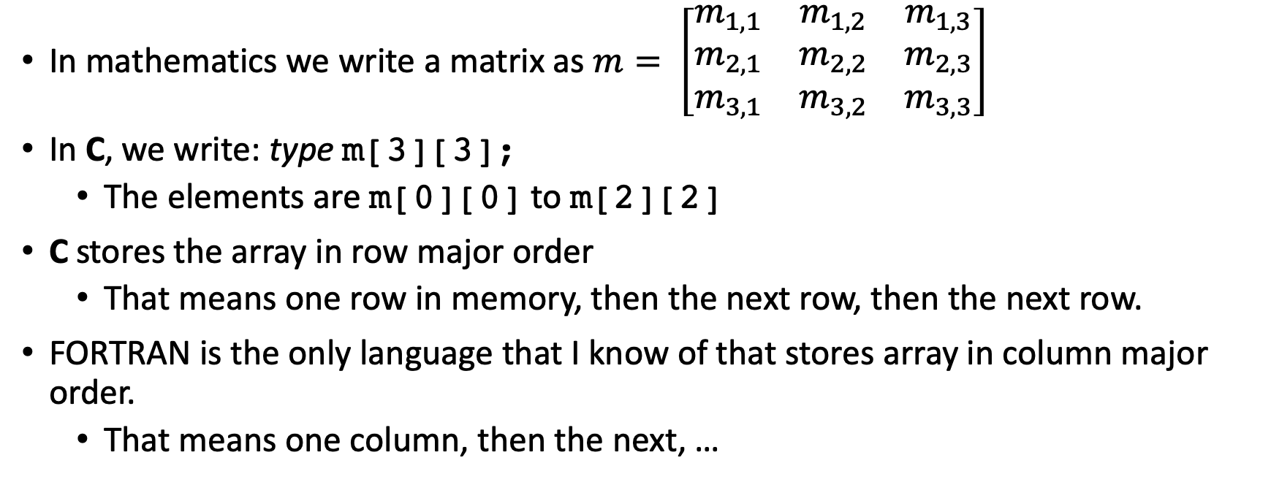
Matrices
In mathematics we write a matrix as $m= \left[\begin{matrix}m_{1,1} & m_{1,2} & m_{1,3} \\ m_{2,1} & m_{2,2} & m_{2,3} \\ m_{3,1} & m_{3,2} & m_{3,3}\end{matrix}\right]$
In C, we write: type m[3][3];
The elements are m[0][0] to m[2][2]
C stores the array in row major order
That means one row in memory, then the next row, then the next row.
FORTRAN is the only language that I know of that stores array in column major order.
That means one column, then the next, …

Slide 7
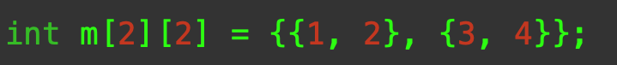
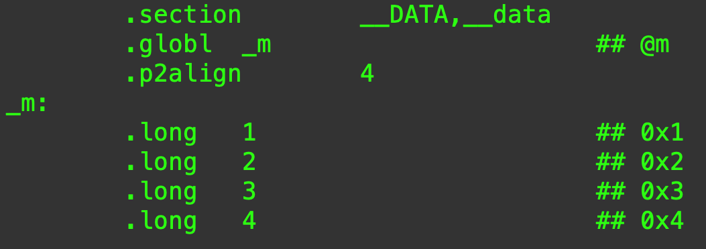
In Memory
Memory is one dimensional.
Rows are laid out sequentially.

Slide 8
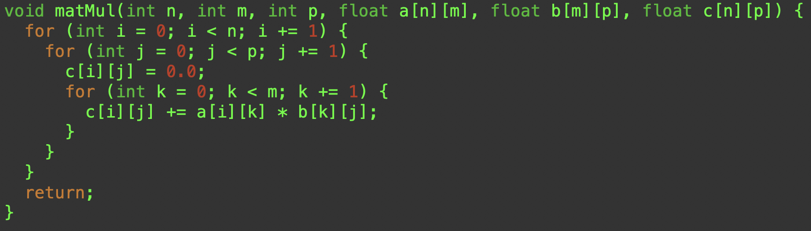
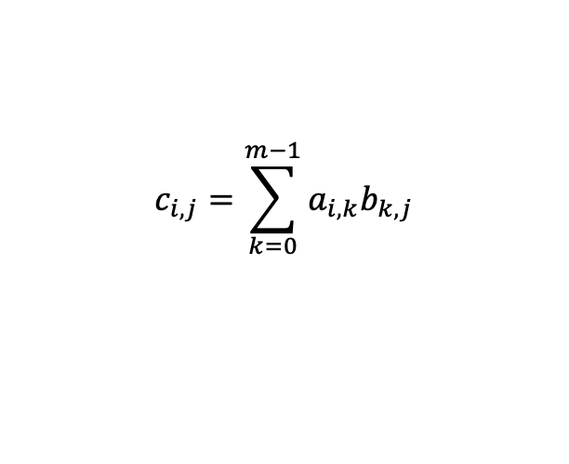
Matrix Multiplication
a, b, and c are all matrices.
Each element is a float.
n is the number of rows in a and the number of rows in c.
m is the number of columns in a, and the number of rows in b.
p is the number of columns in b, and the number of columns in c.
$$c_{i,j}=\sum_{k=0}^{m−1}{a_{i,k}b_{k,j}}$$

Slide 9
How are we changing c[][]?
Arrays are the exception to the rule that parameters in C are always passed by value.
Why is this?
Arrays can be large, so you don’t want to copy them onto the stack.
Does this make sense?
Perhaps surprisingly, it makes perfect sense!
Arrays and pointers are intimately related.
The name of the array is just a pointer to element zero of the array.
Recall that we call this the base address.

Slide 10
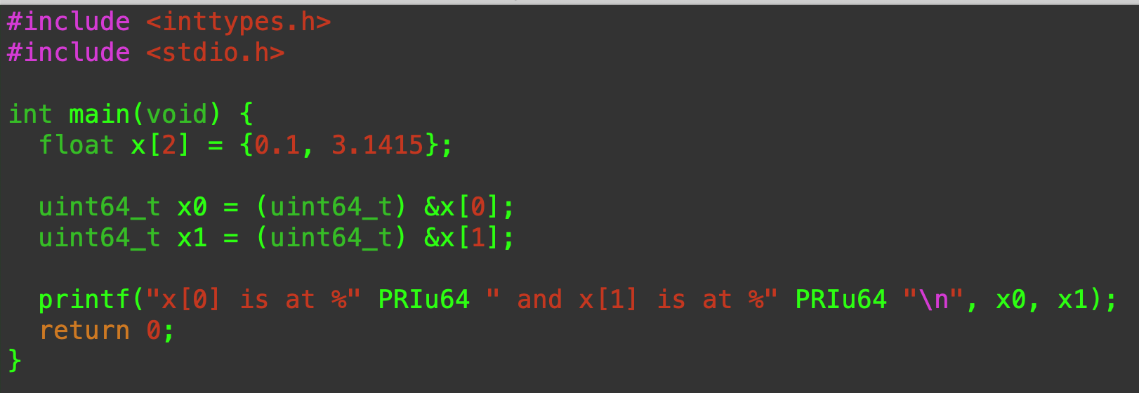
& (address of) operator
& gives the memory location (address) of a variable.

Slide 11
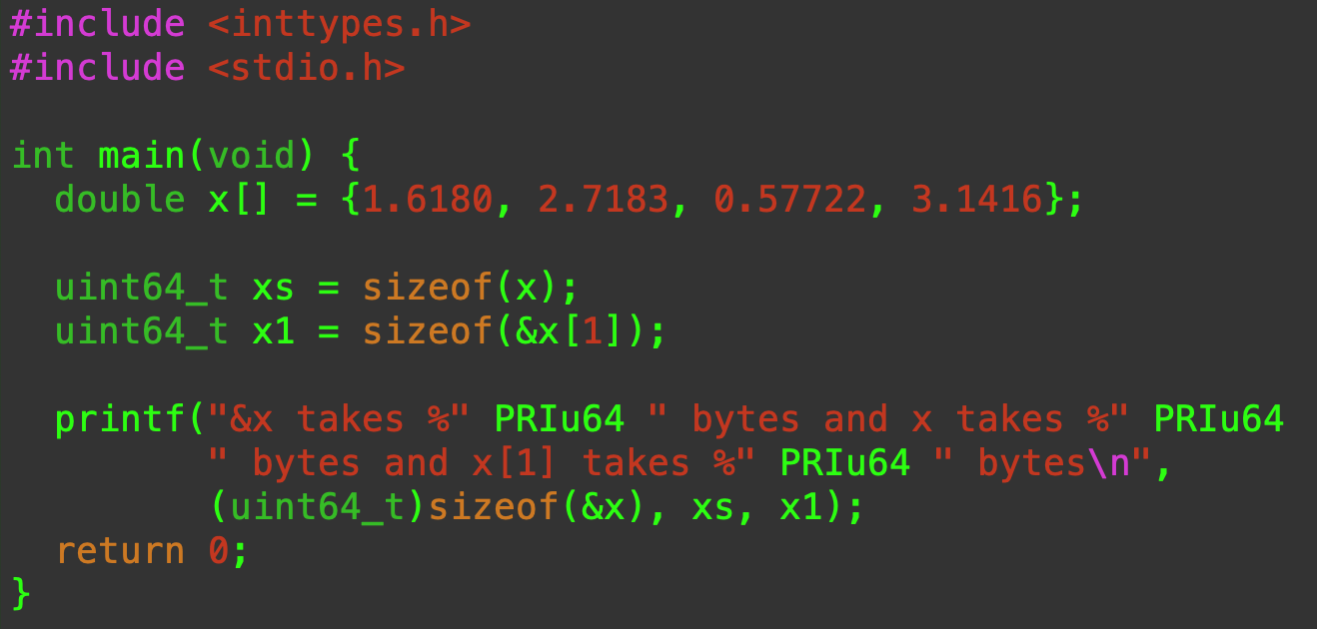
sizeof operator
The sizeof operator tells us the number of bytes used by a variable.
Works on arrays, structures, unions, when the compiler can know how much memory is used.

Slide 12
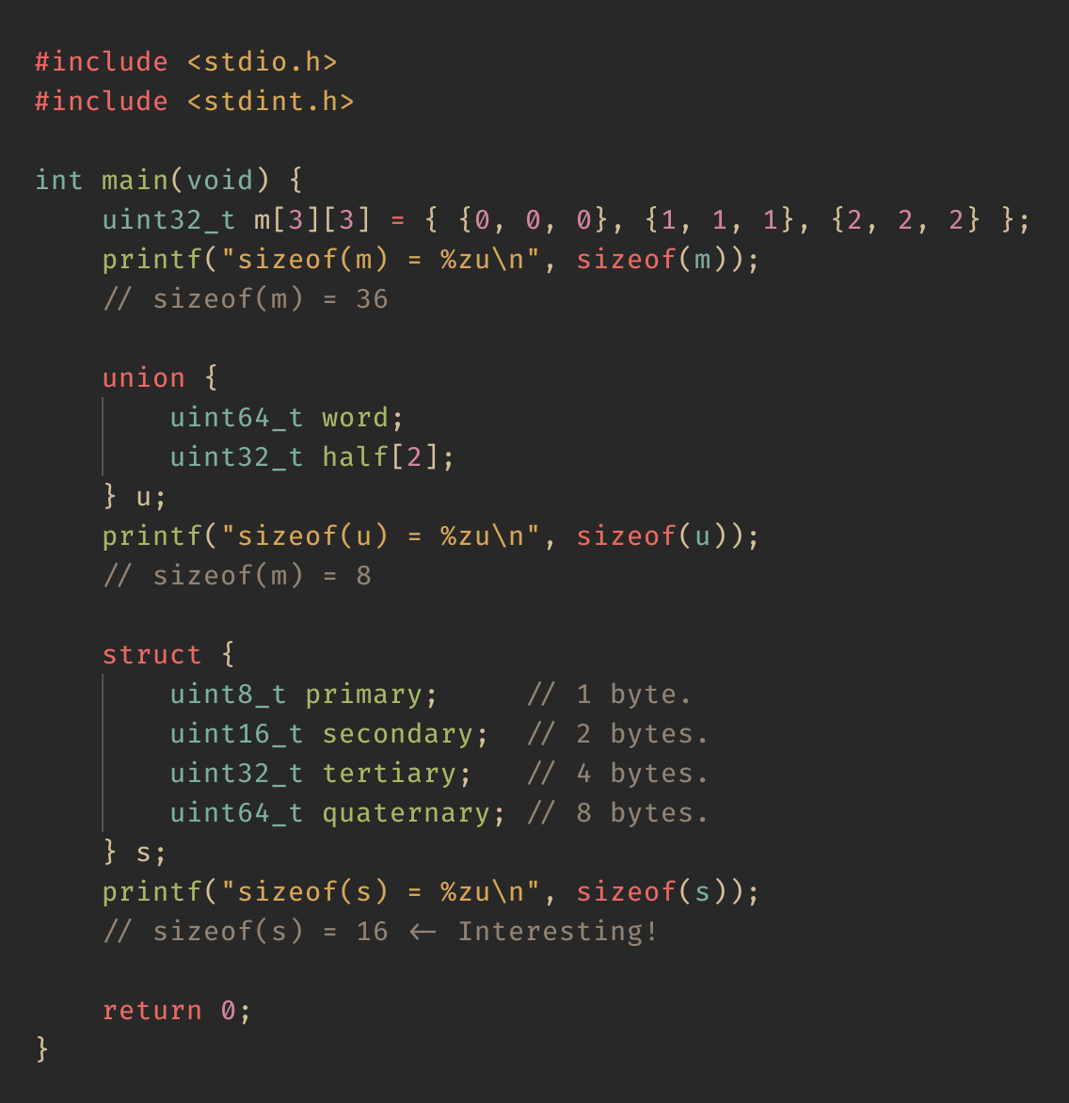
sizeof operator
Some more examples of sizeof.
Note the reported sizeof for the struct.
Why is it not 15?
Because of struct padding.
The compiler may add padding to align nicely with natural address boundaries.

Slide 13
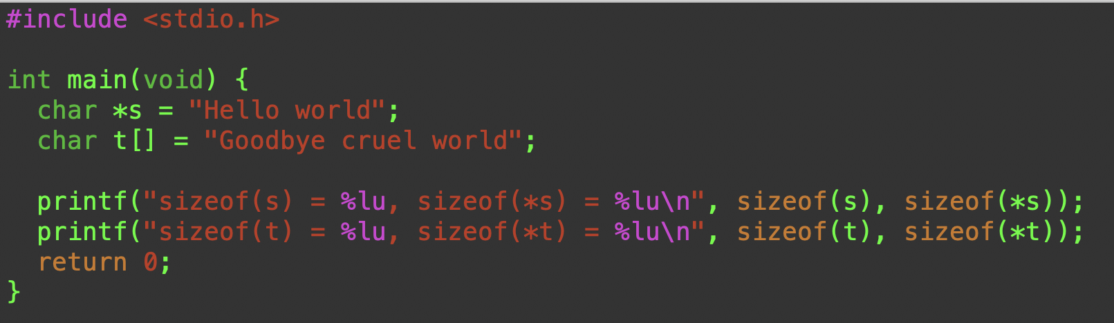
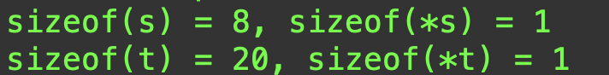
Is this what you expected?
sizeof when applied to an array gives the size of the array.
sizeof when applied to a pointer gives the size of the pointer.
But we said they were the same thing!

Slide 14
Pointers and arrays
Arrays and pointers in C are related in fundamental and often confusing ways.
We will talk more about this when we deal with pointers.
For a single dimensional array,
a[i] == *(a + i)
a is the address of a[0]
a[i] is the array slot that is at a + i * sizeof(a[0])
Pointers automatically do the multiplication by sizeof

Slide 15
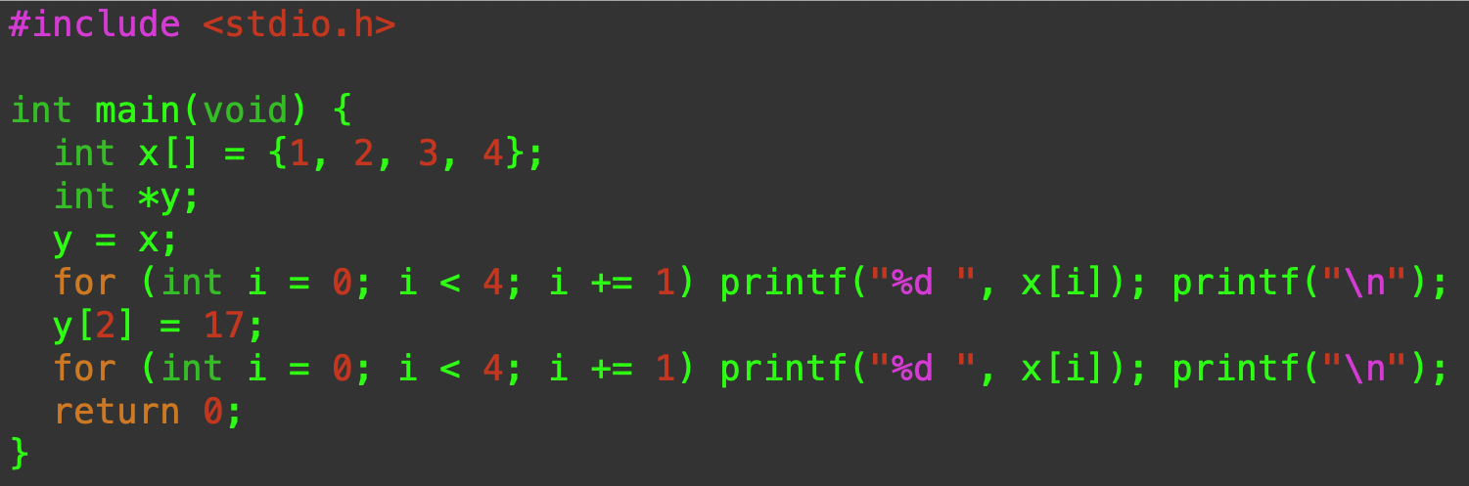
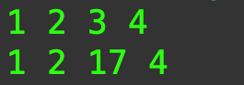
What is going on here?
We’ll use integers for simplicity.
y is an alias for x
They reference the same memory.

Slide 16
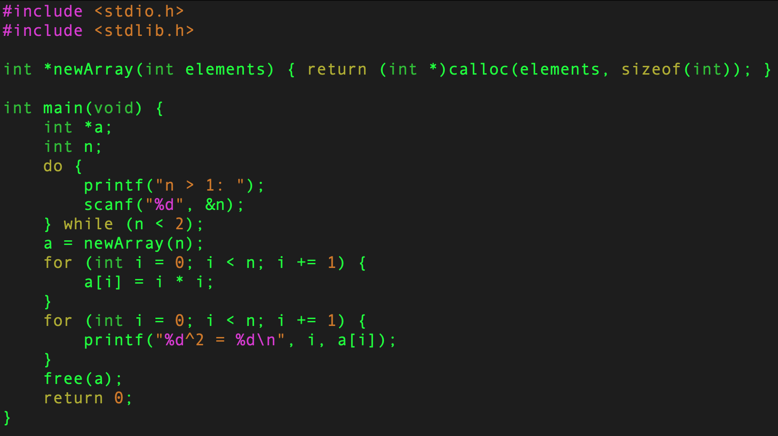
Arrays and pointers are equivalent in C
Returns a pointer to a dynamically allocated array.

Slide 17
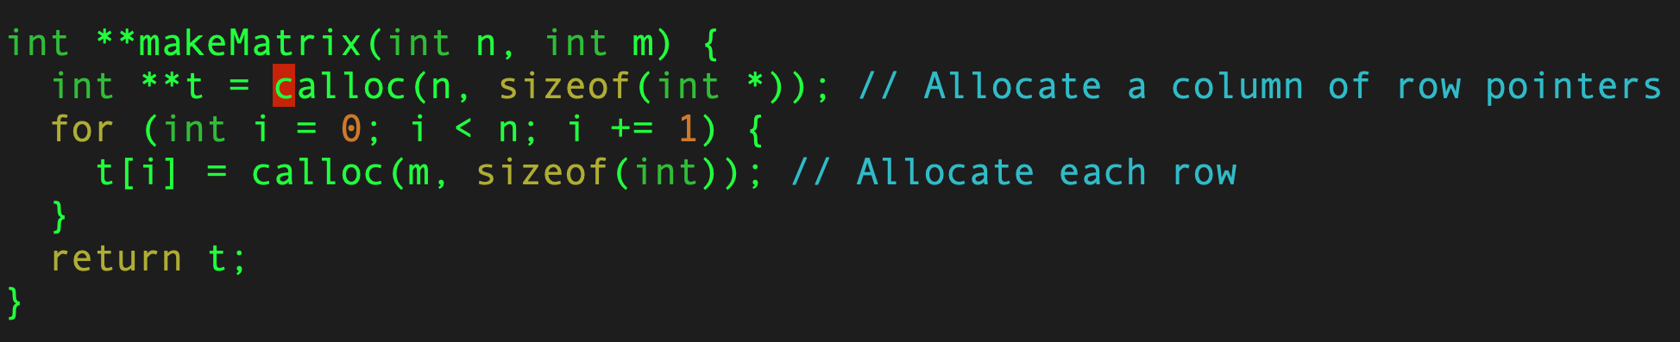
A matrix is an array of pointers
If the matrix is allocated at compile time, it is laid out contiguously.
If you allocate it dynamically, it is an array of pointers to vectors.
The compiler must make it behave the same.

Slide 18
Searching
The task of searching for an element in computer science is incredibly common.
This often entails traversing a collection of elements, such as an array.
Note that the collection of elements need not be in order.
But having the elements in order may have desirable properties.

Slide 19
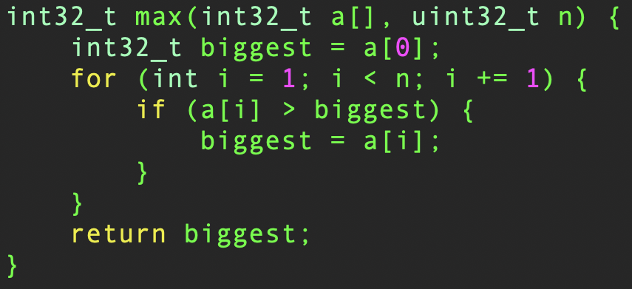
Find the largest

Slide 20
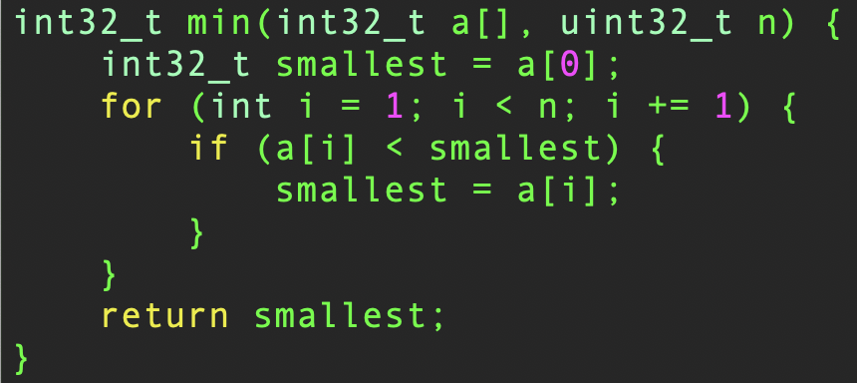
Find the smallest

Slide 21
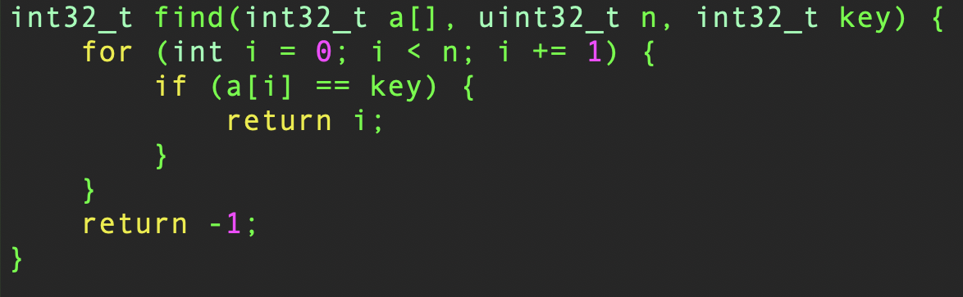
Find an item
Return the (first) index of the key if it exists
Return –1 on failure
What do all these functions have in common?
In the worst case, they must look at the entire array.

Slide 22
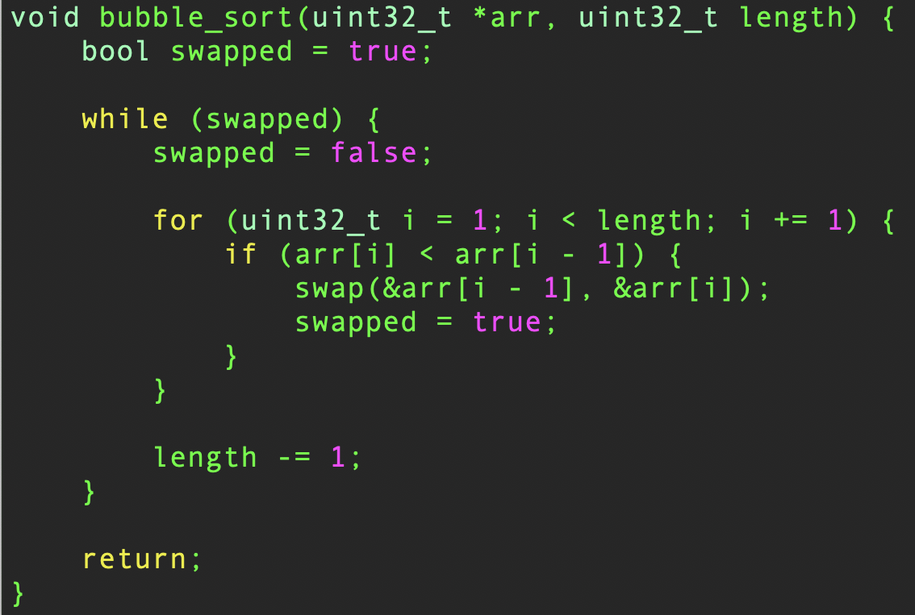
Ordering the array
If we put the array in order, we can search it more efficiently.

Slide 23
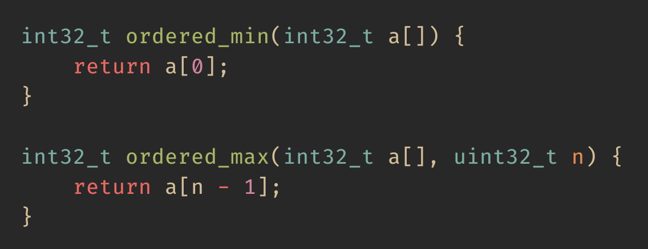
Extrema
If the array is ordered, you can get the minimum and the maximum of the array in constant time.

Slide 24
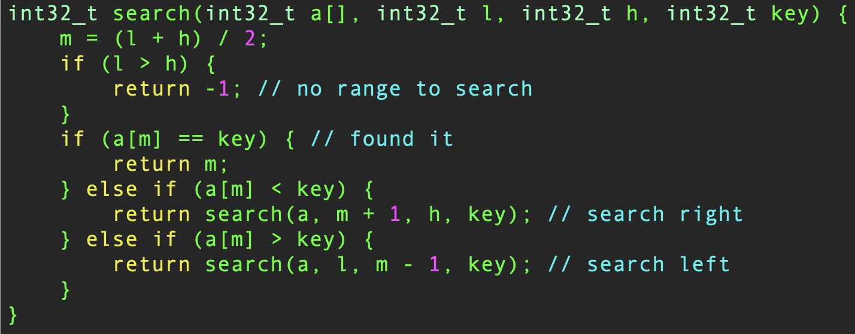
Binary Search
If the array is ordered, this is the fastest you can search.
Is it in the middle?
Too small, look right.
Too big, look left.

Slide 25
What is a string?
In C, a string is an array of characters that ends in ‘\0’
It can be written as:
char s[] = “Hello world!”
char *s = “Goodbye cruel world!”
char s[] = {‘L’, ‘e’, ‘g’, ‘a‘, ‘l’, 0}
Most people use the *s version.
A 100 character (99 printable) empty string is
char s[100]
A string is just an array of characters that we have agreed is terminated by a null (zero) character.

Slide 26
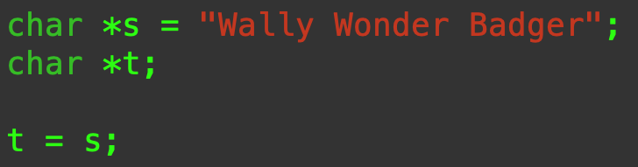
Assignment and Copying
What does that mean?
It means that s and t point to (reference) the same memory location.
It does not make a copy of s.
sizeof does not give the length of the string.

Slide 27
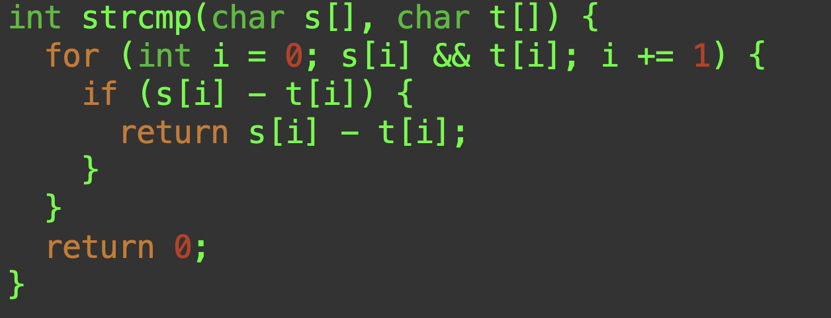
strcmp()
As long as both characters are not null, subtract them.
< 0 means s < t
> 0 means s > t
= 0 means s == t

Slide 28
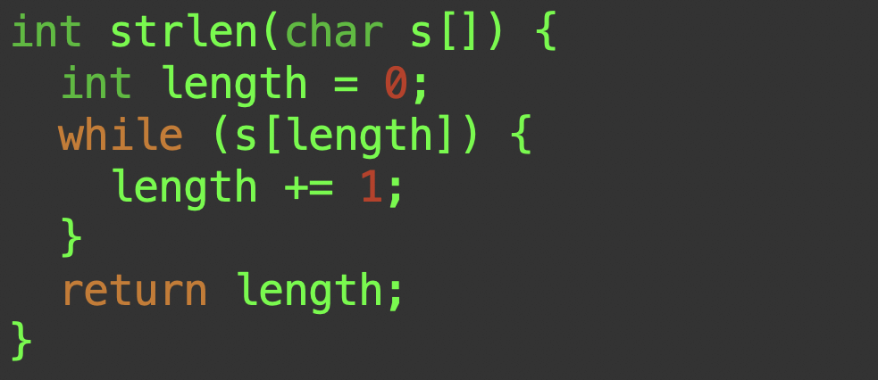
strlen()
As long as s[length] is not null, move on to the next one.
length is the number of non-null characters.

Slide 29
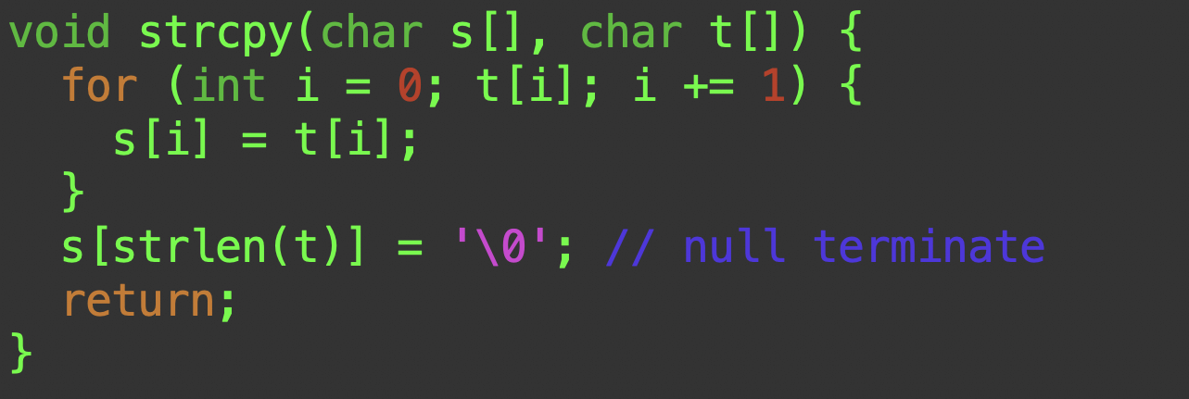
strcpy()
As long as t[i] is not null, copy it to s[i]
And be sure to tack a null on the end

Slide 30
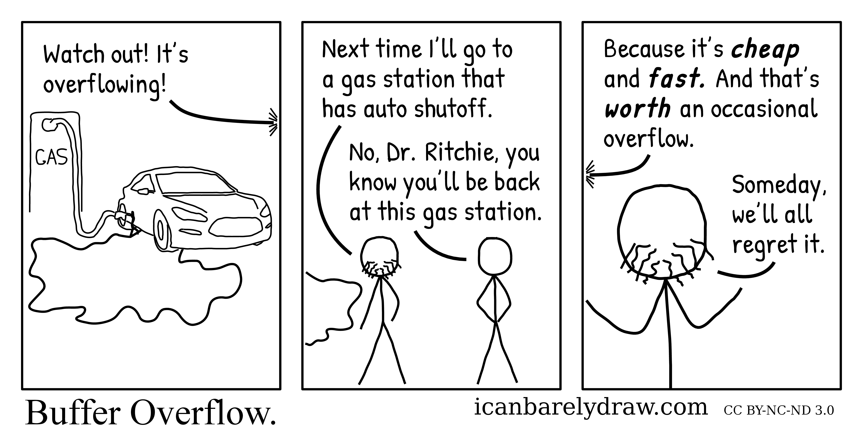
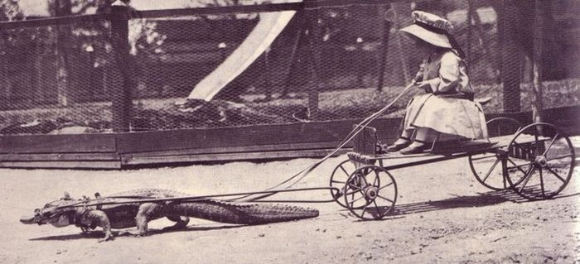
You should never write code like that!
Why not?
Did you check the array bounds?
This is the source of most buffer-overflow attacks!

Slide 31
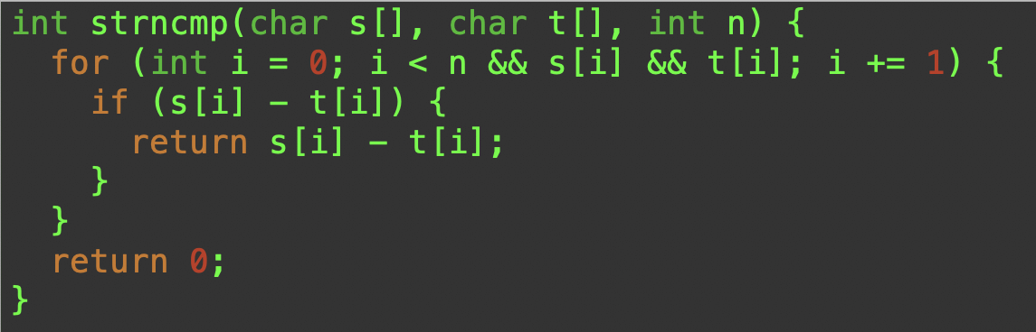
strncmp()
We just have to add a quick check to make sure we haven’t gone too far.
It depends on you knowing how large the arrays are, of course.

Slide 32
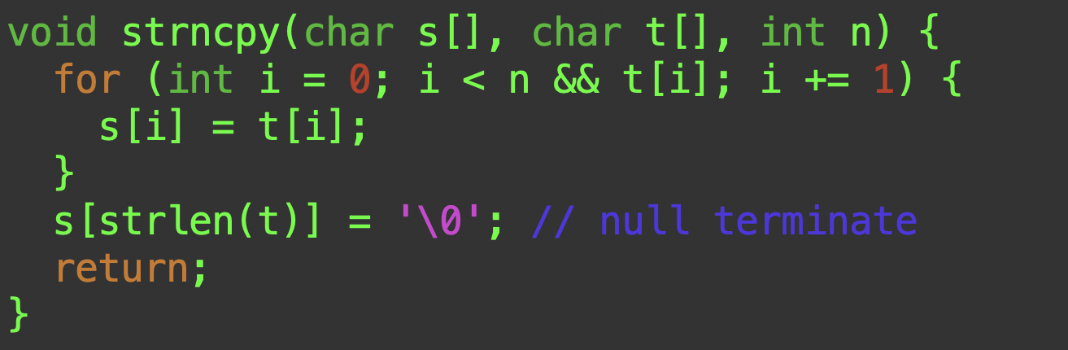
strncpy()
Note that n must account for the null at the end.

Slide 33
Summary
Arrays are homogeneous collections of items.
Array indexing in C starts at 0, the base address.
Arrays and pointers are intimately related.
Arrays can have multiple dimensions.
Arrays are the exception to the rule that parameters in C are always passed by value.
Strings in C are NULL-terminated arrays of characters.

